Slide 1

DESIGN OPTIONS
REVIT University
USES AND WORKFLOWS FOR THE DESIGN OPTION TOOLS
ORB UNIVERSITY – MAY 24, 2023
PRESENTED BY Christian Quintero

Slide 2
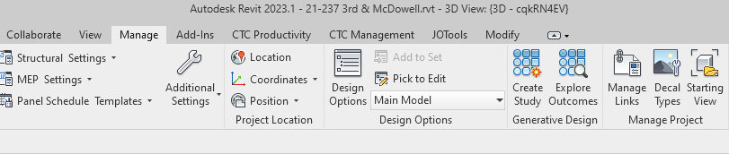
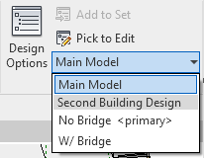
DESIGN OPTION TOOLBAR
Design options is a function in Revit that’s geared towards giving you a way to overlay different alternatives for a design arrangement. This could be temporary for a design study, or permanent ex. an unit design alt.
Dropdown: Here you will see all the design sets you’ve created.

Slide 3
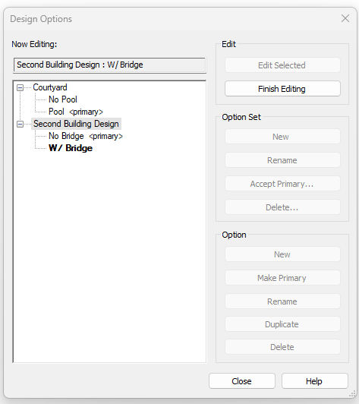
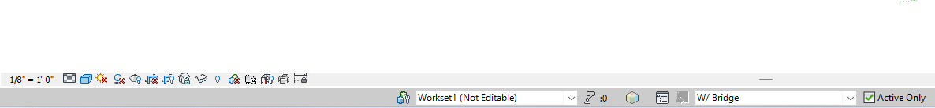
DESIGN OPTION TOOLBAR - EDIT
This tab will let up swap between already created design options. This portion of the option box is not super useful, since you could do the same while modeling though the bottom ribbon.

Slide 4
DESIGN OPTION TOOLBAR – OPTION SET
Option Set – This is the term Revit used to refer to the Topic in which you have design options. Hence you can have as many “Topics” as you need, as long as you keep the design options within the correct Option Set (topic).

Slide 5
DESIGN OPTION TOOLBAR – OPTION SET
Accept Primary – This should only be used when you are 100% sure that the TEMPORARY design options within the set are not needed. When you accept a primary it will of it as resolved, which also:
Deletes all Design Options within the set
Deletes the Option Set
Moves the elements within the Primary into the Main Model.

Slide 6
DESIGN OPTION TOOLBAR – OPTIONS
Options – These are the pockets of information, and you can add as many as desired to an option set.
Primary – The primary design option is what the software considers as existing and current to the project.

Slide 7
DESIGN OPTION TOOLBAR – OPTIONS
Each Design Option (Topic) has its own primary, so make sure to set these accordingly.

Slide 8
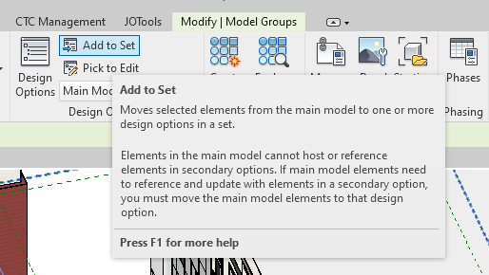
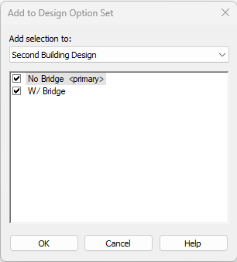
DESIGN OPTION TOOLBAR – ADD TO SET
Add to Set – Once you select an element from the model you can make a copy of it to one or more Design Option Selection.
The item you copy to a design option will be deleted from the main model to avoid geometry conflicst.

Slide 9
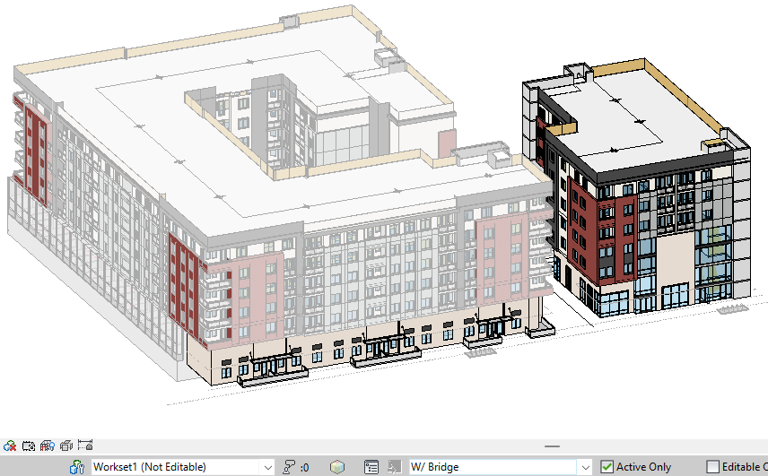
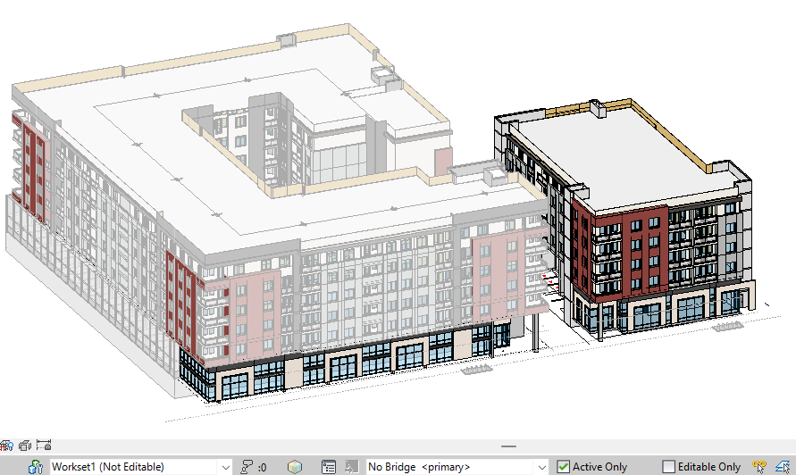
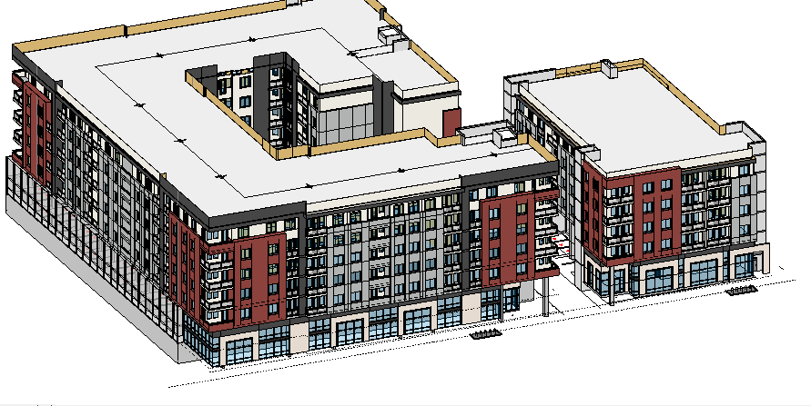
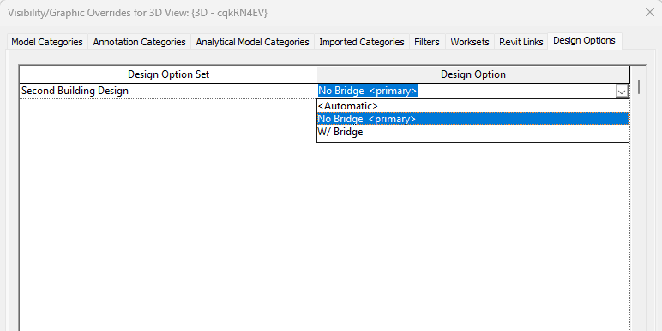
DESIGN OPTION TOOLBAR – ADD TO SET
Once the design options are set you can toggle between options through the G/O Override tables.

Slide 10
DESIGN OPTION TOOLBAR – ADD TO SET
Once the design options are st you can toggle between options through the G/O Override tables.

Slide 11
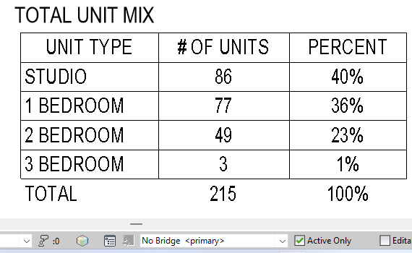
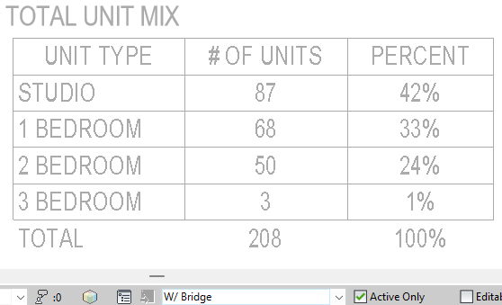
DESIGN OPTION TOOLBAR – SCHEDULE
Schedules are also affected temporarily by design options. Which you can manage at the bottom ribbon.
Note: This is the design option of the model itself and not the view. Hence why is affects schedules.
Note how the non-primary options show up half toned on your screen, to indicate this is not the current version. This will not print halftoned.

